Slide 1



Backend Operations Training
VLOOKUP & HLOOKUP
Essentials
Master data retrieval efficiency in backend workflows.
BY: SUBHRA SINGH

Slide 2

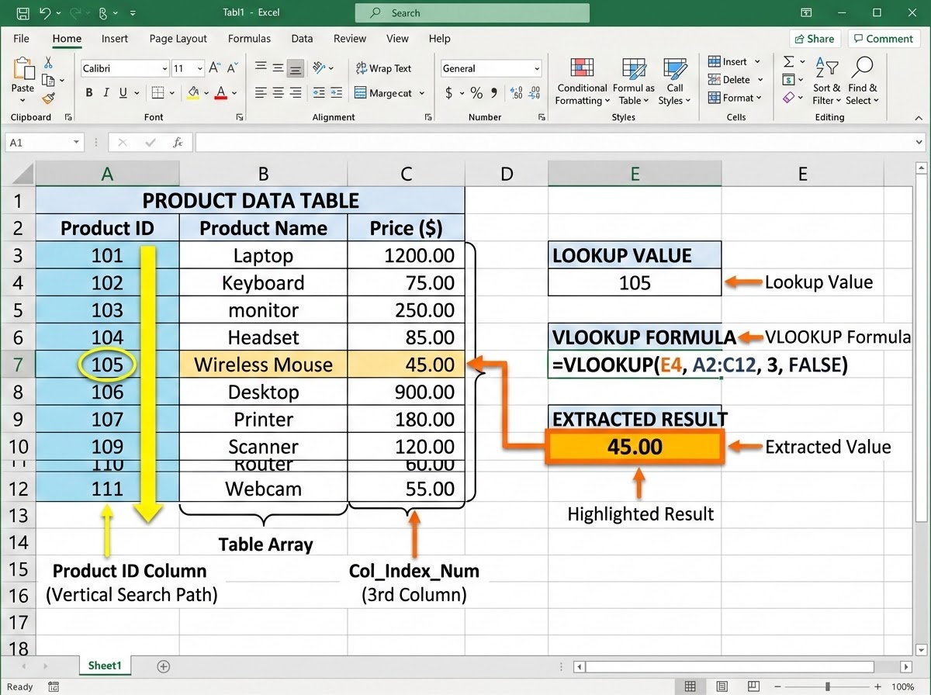
Master Vertical Searches for Backend Databases
Understand the mechanics of vertical data retrieval to streamline database queries.
• Syntax Breakdown: =VLOOKUP(lookup_value, table_array, col_index_num, [range_lookup])
Key Parameters:
Define the lookup value, specify the table range, set the column index, and use FALSE for an exact match.
Real-World Scenario:
Quickly retrieve employee details or transaction statuses from a large vertical database table using a unique Employee ID or Order ID.

Slide 3
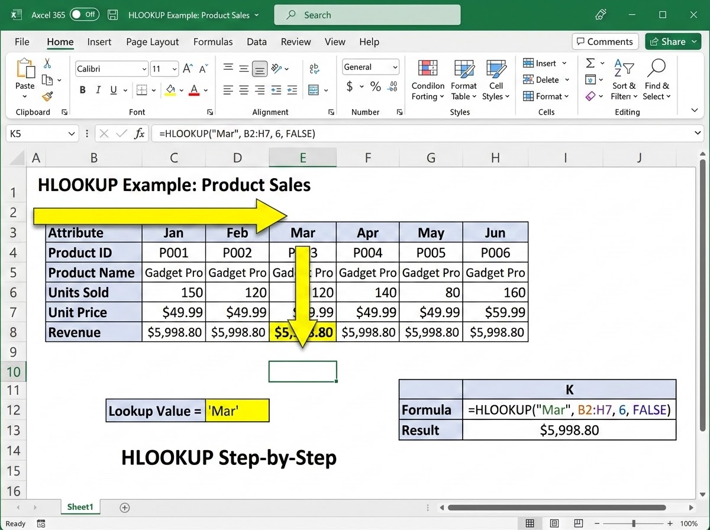
Execute Horizontal Searches for Row-Based Data
Utilize horizontal search mechanics for wide datasets.
Syntax Breakdown: =HLOOKUP(lookup_value, table_array, row_index_num, [range_lookup])
Key Parameters: Define the lookup value, specify the table range, set the row index, and use FALSE for an exact match.
Real-World Scenario: Efficiently fetch tax rates, discount tiers, or quarterly metrics that are structured horizontally across row headers.

Slide 4
Choose the Right Lookup Tool for Your Data Layout
Align your formula choice with the structural layout of your backend data.
DECISION RULE
DATA LAYOUT
VLOOKUP: For vertical columns
HLOOKUP: For horizontal rows
INDEX REFERENCE
VLOOKUP: Relies on a Column Index
HLOOKUP: Requires a Row Index
Evaluate Source Structure
Always evaluate your source data structure before writing the formula to ensure accurate data retrieval.
Matching orientation prevents formula errors and optimizes backend lookup efficiency.
RECOMMENDED RESOURCE
Excel VLOOKUP & HLOOKUP Tutorial
[link removed]

